Slide 1

Philanthropy is a multifaceted and complex subject. Specifically, in disaster relief - Given that each disaster is unique, and that the ruling government has its own set of cultural norms, a transparent system that is borderless and does not rely on local actors to behave fairly or honestly is essential. There continues to be millions of dollars of aid which is stolen, damaged, or simply “lost” in the incoherent shuffle of the crisis setting annually – bypassing the intended recipients who are in crisis.

Slide 2
Blockchain Philanthropy

Slide 3


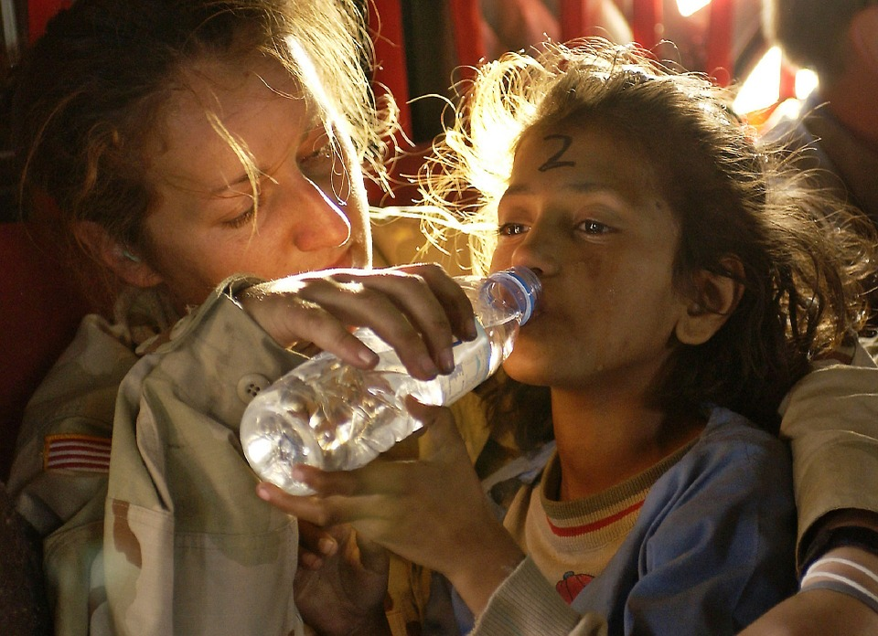


Bringing transparency to Humanitarian Aid

Slide 4
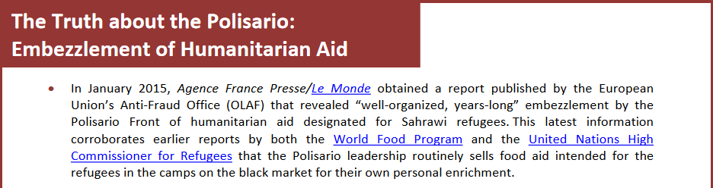
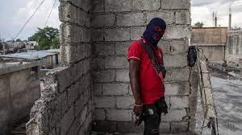
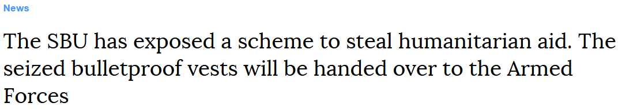
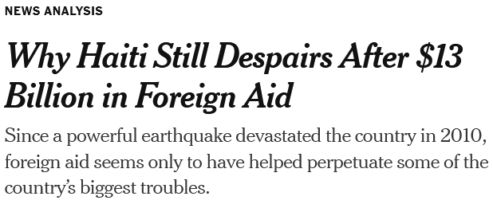
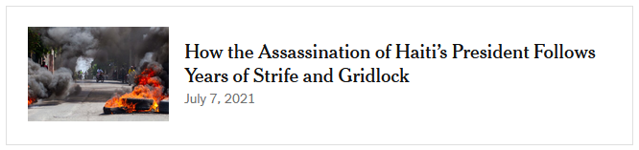
Why is transparency important in crisis?
What can be the long-term consequences of ambiguous charity?

Slide 5
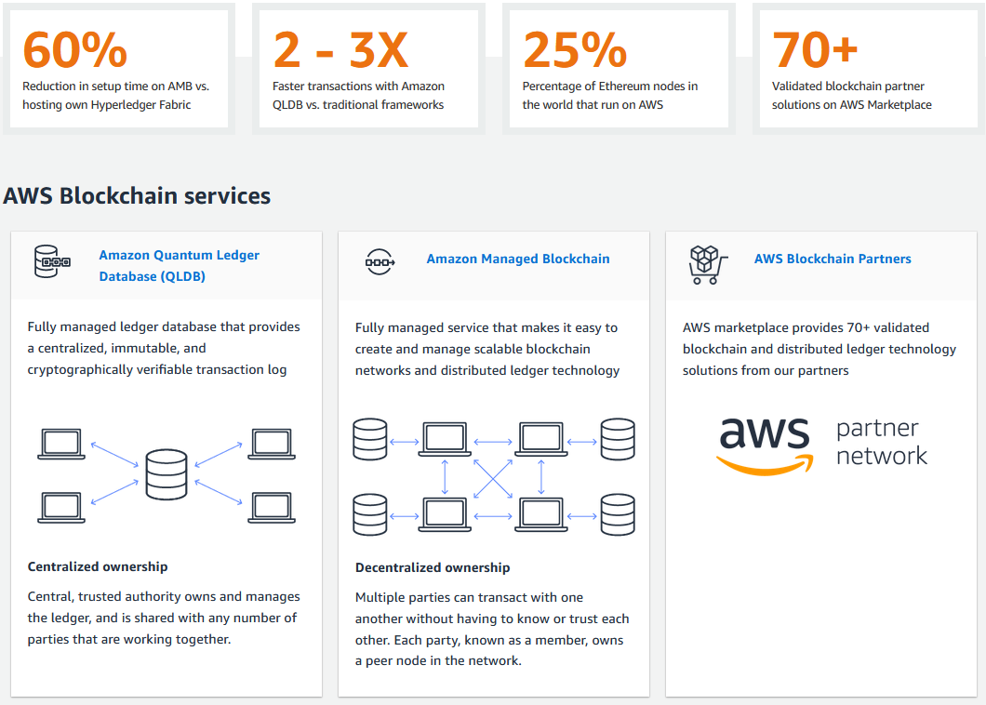
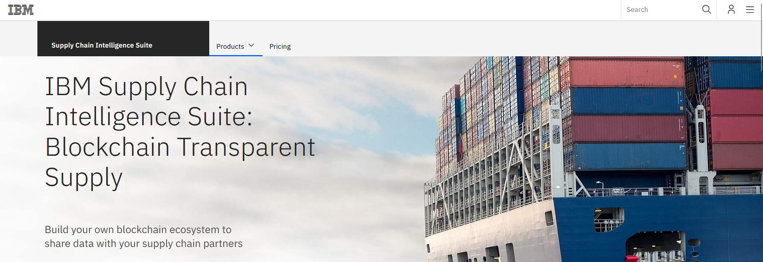
What companies have embraced Blockchain to clarify the supply chain?
And many others…

Slide 6
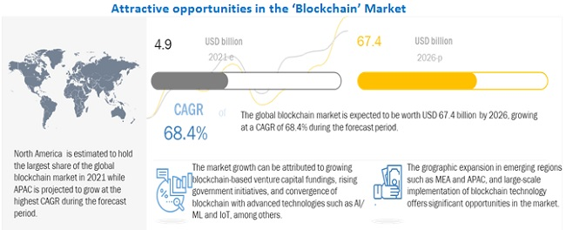
Projected Growth
Notes:
Compound Annual Growth Rate

Slide 7
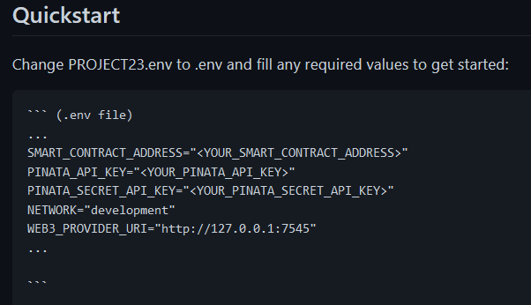
Project Framework
Requirements
Streamlit
Pinata
Python
Truffle Suite (Ganache)
Web3 (Solidity)

Slide 8
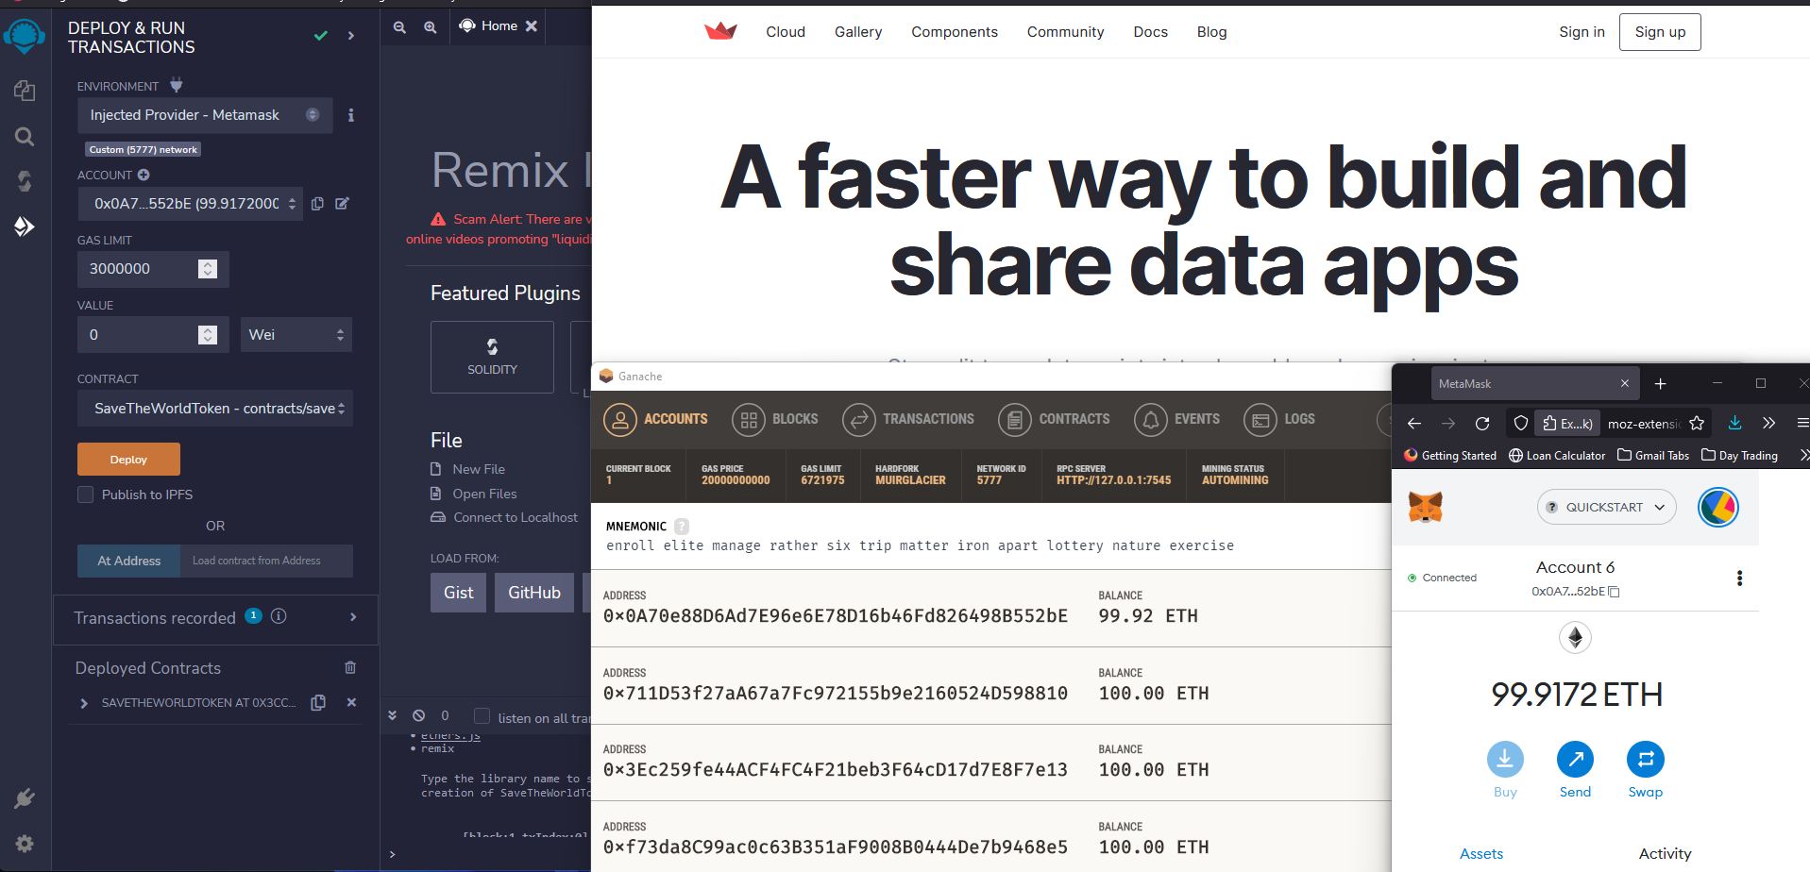
UI / UX

Slide 9
Outline
View Organizations Page
create interface via streamlit for donors to view “screened” organizations
Donor to select an organization
populate items which represent an organizations items
Donor to select item
which has a set value, to purchase using “Ethereum”
Click “Donate”
Mints the NFT and saves image & metadata to https://pinata.cloud
transaction stored on local blockchain
Purchased Item to be “minted” and tokenized as NFT
Interplanetary File System
Generate donation receipt

Slide 10
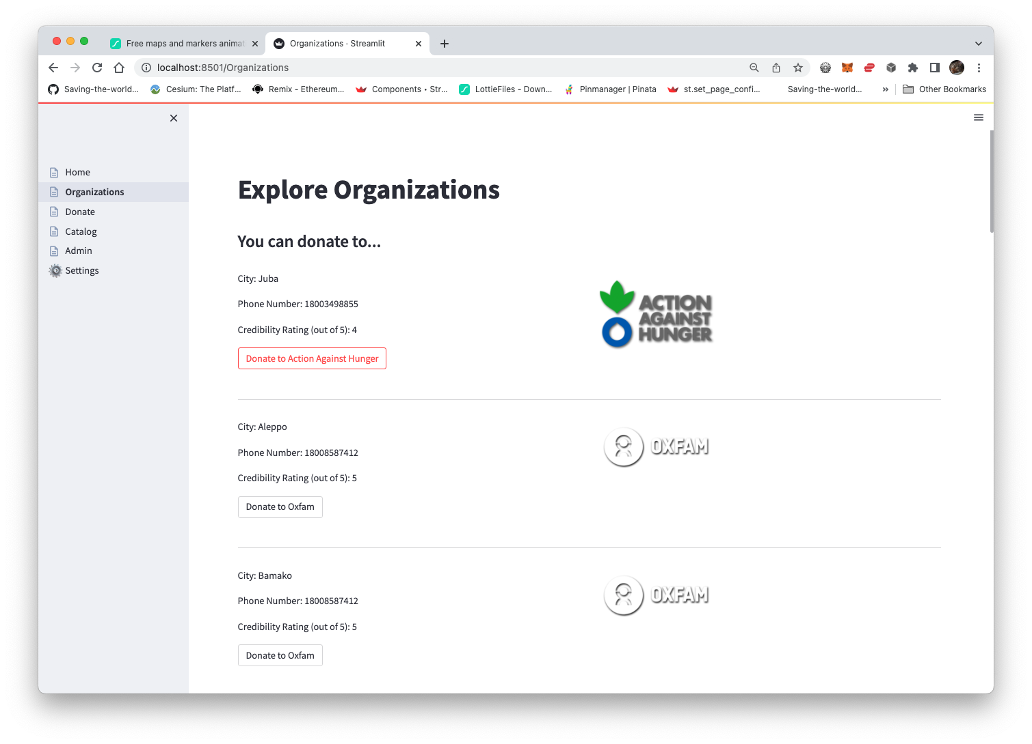
View Organizations Page
Viewing a catalog of available organizations and the assets they require

Slide 11
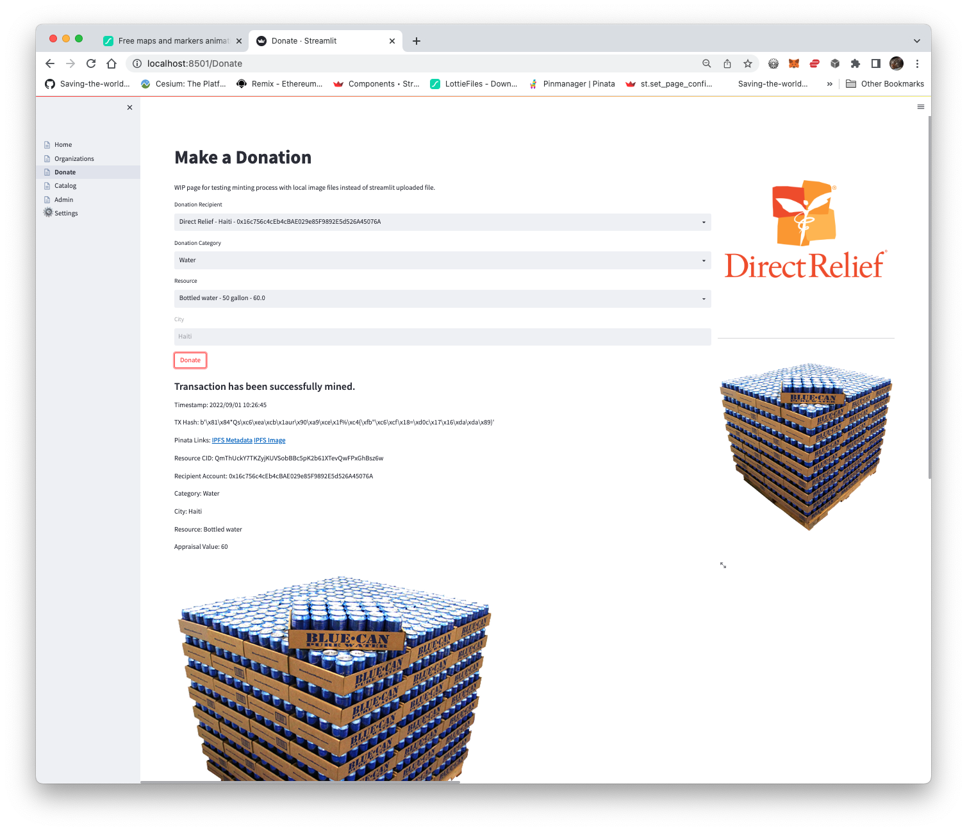
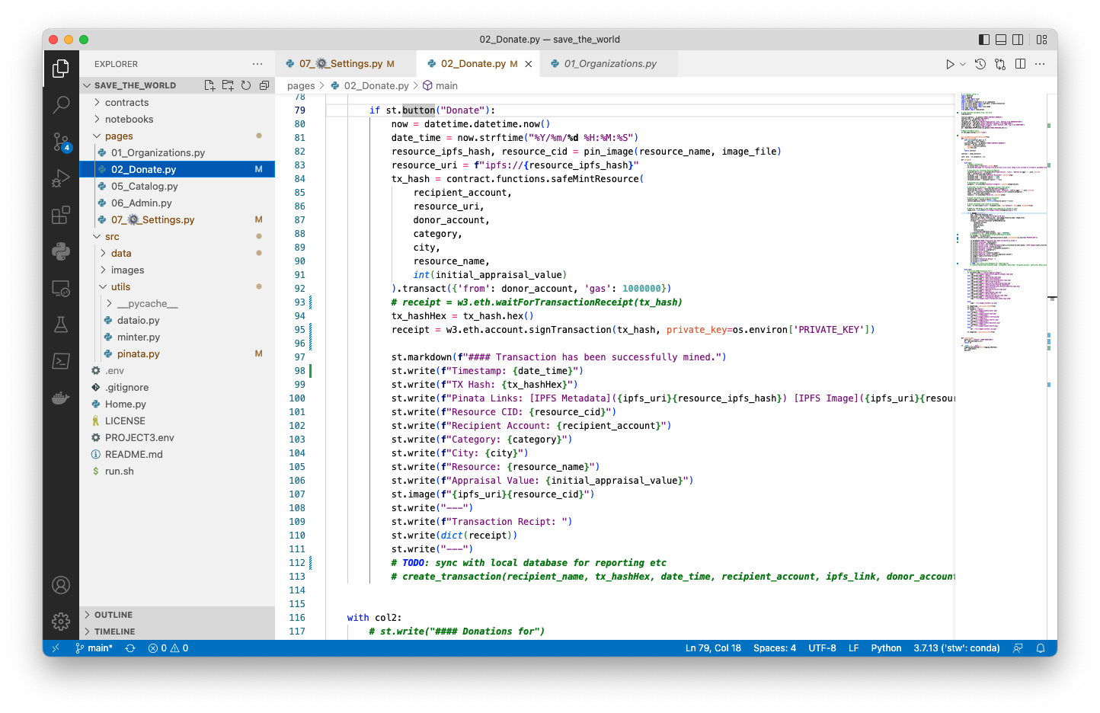
Donor to select an organization

Slide 12
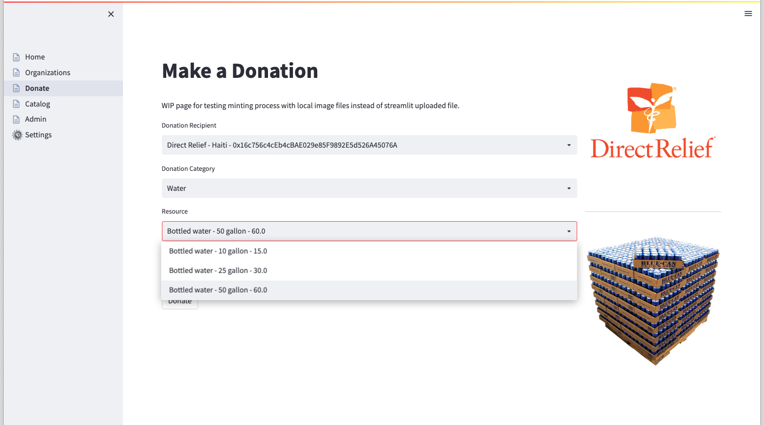
Donor to select Item

Slide 13
Click “Donate”

Slide 14

Purchased Item “minted” and tokenized as a smart contract
Open zeppelin ERC 721 smart contract(NFT)
Create roles within contract for custom delegation(NGO, local, etc.)
Functionality can be delegated specific to the organization
IPFS CID tokenization

Slide 15
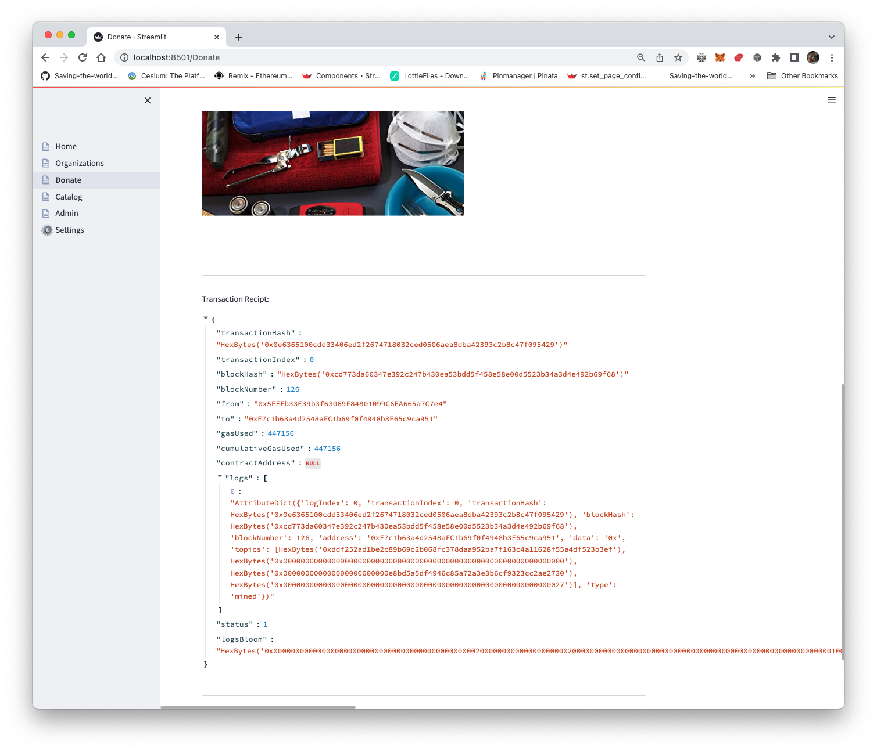
Generate Donation Receipt
Valuable for building out a system

Slide 16
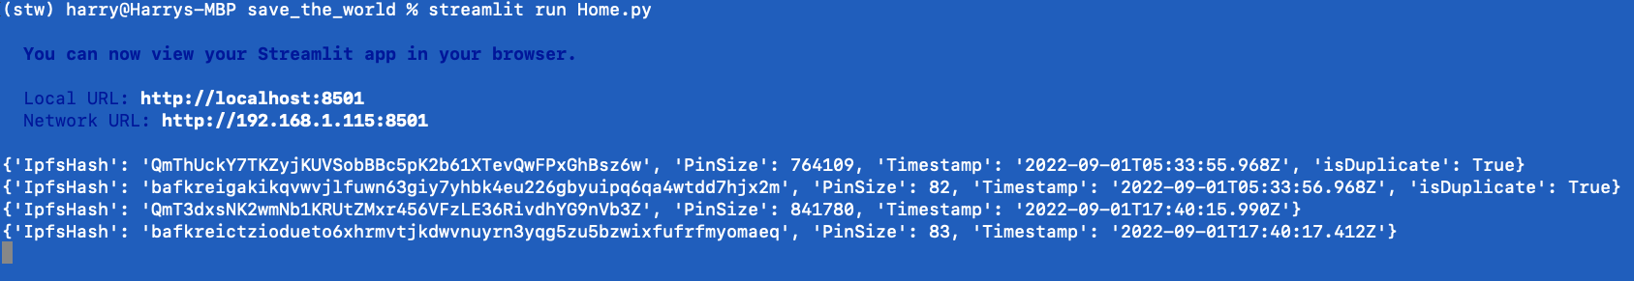
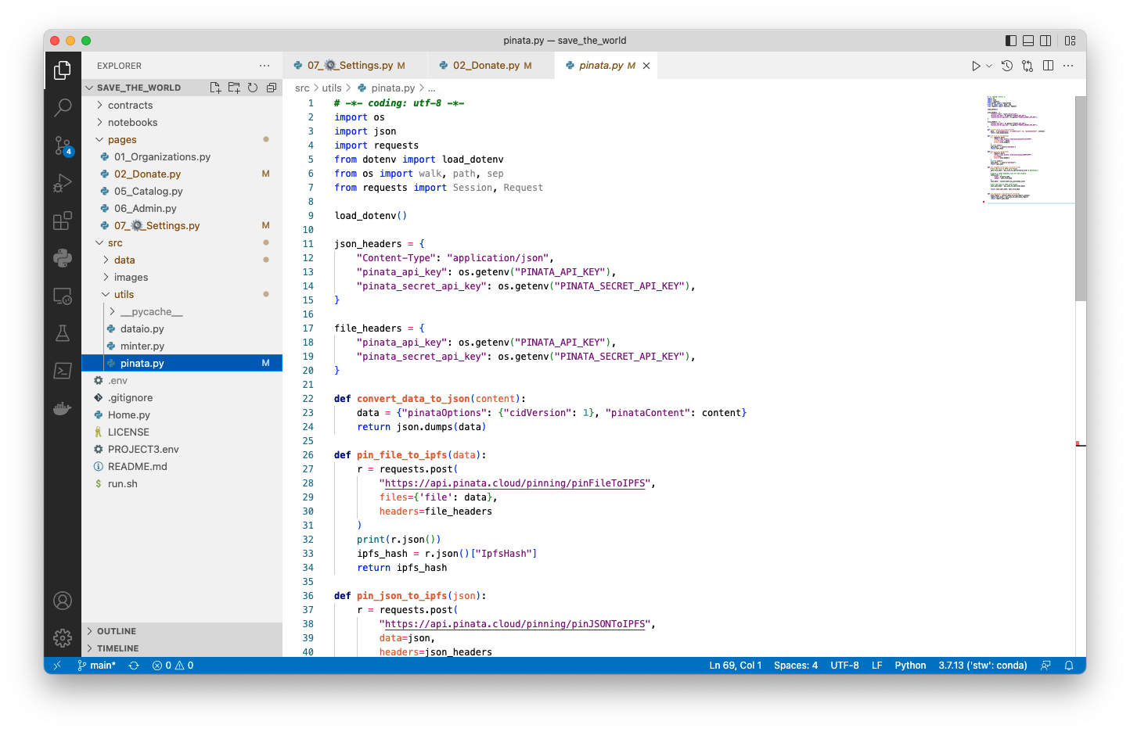
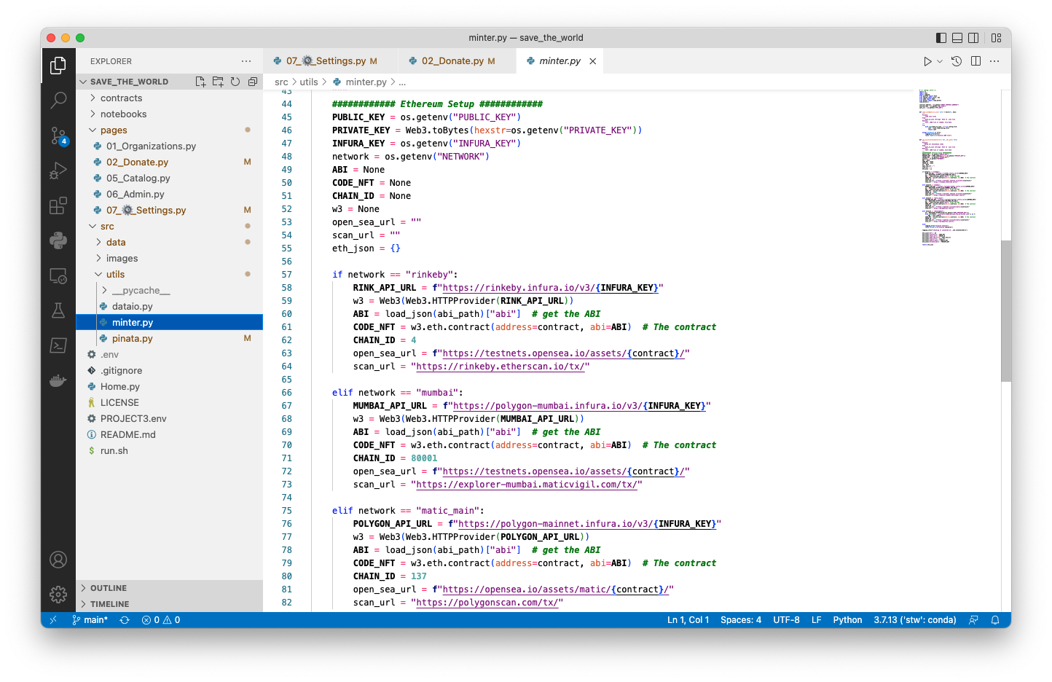
Extra Goodies
Streamlit Logging
Handy for building out a solution that integrates with management systems
Can be scaled to Public Blockchains in future

Slide 17

Live Demonstration

Slide 18
Unanticipated Insights
Not much data available to create a test environment
Very complex system using existing tools to mint and connect various elements.
Limitations with Streamlit (would rebuild in Django if we didn't have a tight schedule.)
Big discrepancies across Solidity versions due to rapid evolution of technology stack.

Slide 19
Gas Fee Improvements & Kevin Questions
Offset IPFS to another location (AWS)
If infrastructure available, install IPFS on local server
Spin up our own Ethereum node

Slide 20
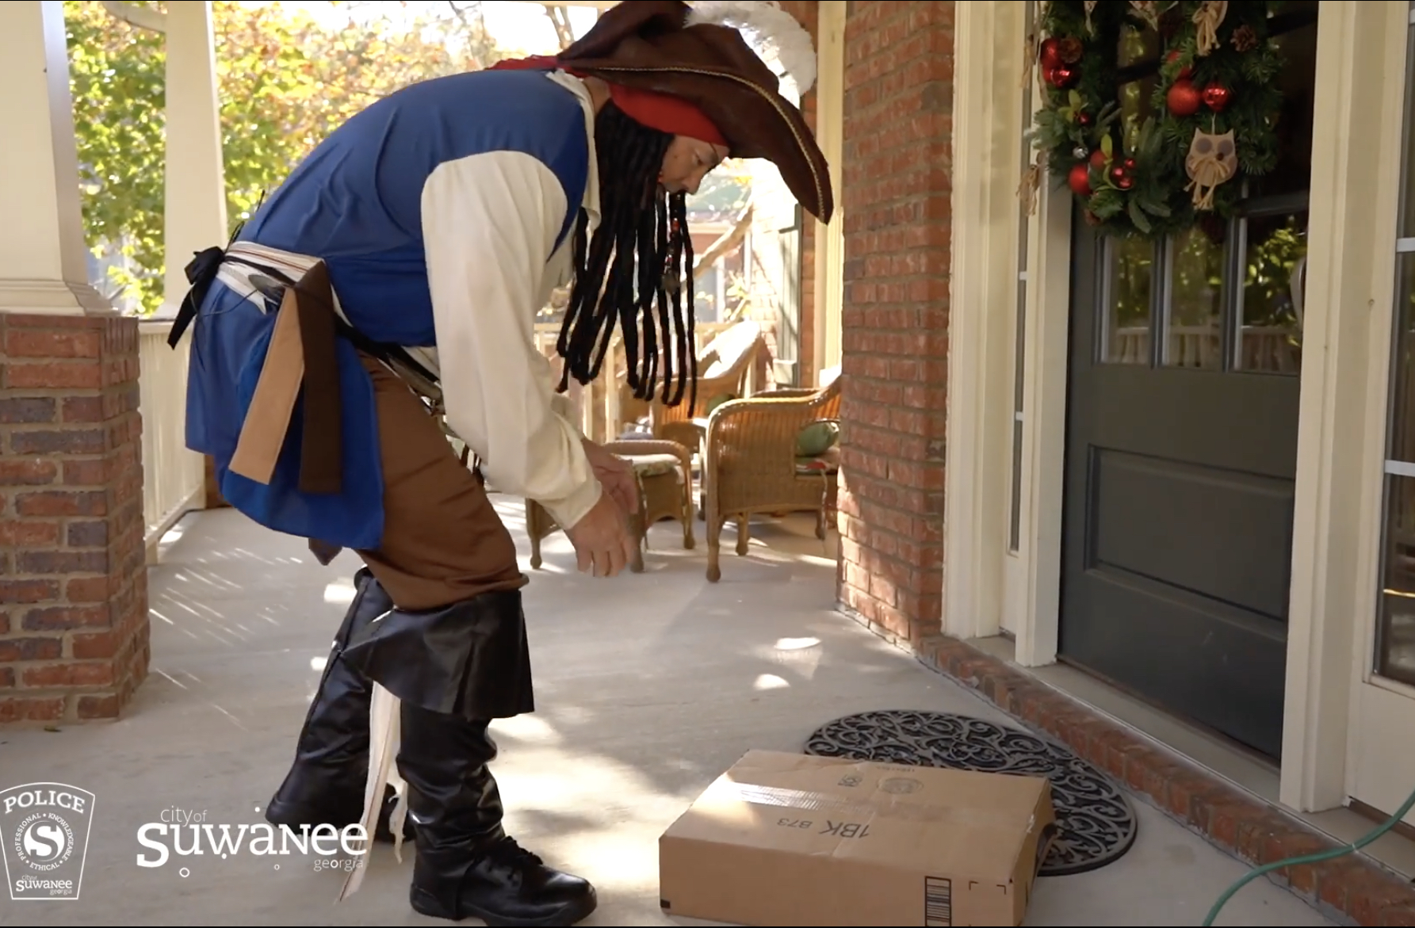
Future Features
Partner organizations to be authenticated
Tracking ability
Donor wallet integration (MetaMask)
Organization (clients) Management
Configuration Pages for user access, database management, Org management
Smart Contract Management (Roles delegation, governance, etc)

Slide 21
Nefarious Crew
Harry “Max Minter” Oestreicher
Phoebe “IPFSensation” Gunter
Gabriel “The Sage” Paganin
Abhi “Super Chill” Banerjee
Javier “Sweet Tunes” The Dude
Gerald “Cool, it works?” Cortright

